Slide 1
Smart Data Access with Dapper
Daniel Larsen
@DanielLarsenNZ
dlarsen@spendvision.com

Slide 2
Today’s presentation
Part 1
Hello Dapper
Part 2
In the stack
Part 3
Unleashing legacy code

Slide 3

“Software design is a constant battle with complexity”
- Eric Evans, Domain Driven Design

Slide 4

About Dapper
@SamSaffron
“Micro ORM”
MIT and Apache licenses.
http://code.google.com/p/dapper-dot-net/
https://github.com/SamSaffron/dapper-dot-net
Notes:
Dapper was written by Sam Saffron for Stack Overflow’s web app, while he was working there, over two years ago.
It’s a so-called “Micro ORM” because it is a tiny library, one file about 3,500 lines of code.
But it’s not really a full ORM, more a building block for your own, as will quickly become clear in this demo.

Slide 5
3 Helpers
Extends IDbConnection with 3 extension methods:
Query<T>()
Query()
Execute()

Slide 6
How does it work?
Takes SQL as a DSL for querying the DB
Executes as parameterised query (sp_executeSql)
Inspects the model <T> using IL (for speed) and “deserialises” the SqlDataReader into the model’s properties where it finds commonality.
https://gist.github.com/SamSaffron/893878
Notes:
The original gist is 169 lines of code.

Slide 7
Demo
Hello Dapper

Slide 8
In the stack
Dapper at work

Slide 9
My stack
Existing
Some legacy
Brownfields approach
Complex domain
Some integration
Scale

Slide 10
My stack
Web client
3rd-party web-services
ASP.NET MVC, C#
ASP.NET, VB.NET
ORM
Stored Procs
DBs
SSIS
Notes:
TODO: Animate

Slide 11
The magic of ORMs
DB-first generated entities
Powerful object mapping
“Coupling” of DB schema to .NET code
Lots of helpers (CRUD)
Linq to Entities, IQueryable, IQueryProvider

Slide 12
The pain of ORMs
Linq to entities is too good to be true
Single query problem
Projections are tricky
Complexity
Notes:
TODO: Asprin bottle

Slide 13
Case study
The YTD sales report

Slide 14
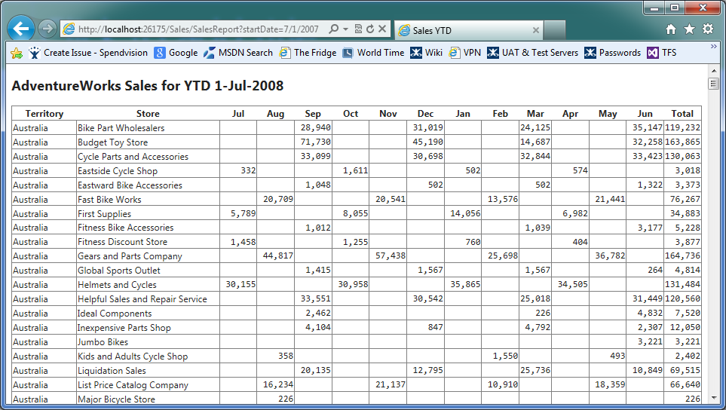
Notes:
* Not a great example as this would typically be generated off a DW as part of an overnight process. However is a good example of the type of projections that we routinely create on realtime data.

Slide 15
Sales
SalesOrderHeader
SalesOrderId
TotalDue
OrderDate
Territory
Customer
SalesTerritory
Customer
Store
Name
Store
Name
http://merc.tv/img/fig/AdventureWorks2008.gif

Slide 16
Demo
Projected query

Slide 17
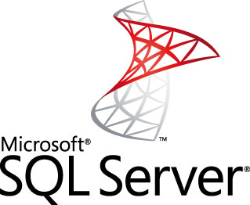

Falling back in love all over again…
Insert licensed image of couple running hand in hand through the meadows. Their heads are logos.

Slide 18
Getting Dapper into the stack
It’s (probably) not going to replace your existing ORM
It’s another tool in the tool-belt for Data Access
Particularly well suited for Query (read-only) services

Slide 19
CQRS
UI
Command model
Query model
Tx’s
Commands
Read
http://martinfowler.com/bliki/CQRS.html

Slide 20
Poor man’s CQRS
UI
Command services
Query services
Read-only services
Existing ORM
Dapper
DB
Notes:
TODO: Add CQRS link
TODO: Animate

Slide 21
Bounded context
Web client
3rd-party web-services
ASP.NET MVC, C#
ASP.NET, VB.NET
ORM
Stored Procs
DBs
SSIS
Notes:
TODO: Animate

Slide 22
Anti-corruption layer
C# Domain library
Anti-corrupt-tion layer
Legacy library
CSPROJ
CSPROJ, exposing shiny service interfaces
Old VB.NET and/or Proc library

Slide 23

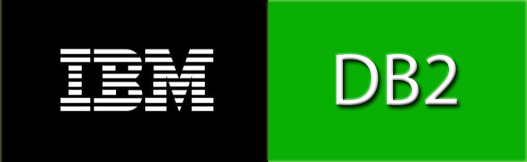


Any ADO provider
sqlite, sqlce, firebird, oracle, MySQL and SQL Server, and more…

Slide 24
Demo
Bounded Context project

Slide 25
Summary
Dapper is a powerful tool to add to your Data Access toolbelt.
Bounded context allows you to use legacy libraries without corrupting your shiny new stack.
Combined, they can simplify your query model, and breathe new life into your legacy code.

Slide 26
Thank you
@DanielLarsenNZ
dlarsen@spendvision.com
Spendvision.com/Careers

Slide 27








MS Communities & code camp sponsors

